Slide 1

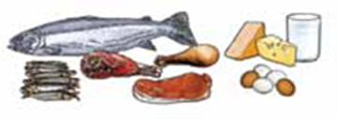
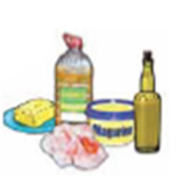

Nutrition
Eating & Drinking
Children with disabilities

Slide 2
What difficulties do your children have with eating & drinking?

Slide 3
Difficulties children with disabilities have
Chewing
Swallowing - coughing / choking / chest infections
Communication – can’t indicate hungry, full etc.
Self-feeding – unable to self-feed OR puts too much in the mouth at once OR eats too quickly
Vomiting / regurgitation (‘reflux’)
Fussy eating or refusal to eat

Slide 4
Possible Consequences
Can’t always eat all types of food or eat enough food at each meal (gets too tired) malnourished & sick
Can’t drink enough dehydrated and constipated
Food goes the wrong way, onto the lungs chest infections

Slide 5
What are the biggest issues for you?
How do you get round them?

Slide 6
Nutrition
Why is nutrition important for children?
  Survival, growth and development
  Good health
  Energy
  Mental ability
  Well-being
.

Slide 7
How do we achieve good nutrition?
Enough food
Good food
What is good food?

Slide 8

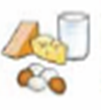

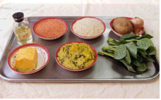

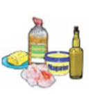


A balanced diet

Slide 9
What food is good for children with disabilities?
High nutrient density for all
High calorie - for CP/physical problems
Smooth consistency - for CP/physical problems
Foods to avoid for children with Autism –additives and sugar

Slide 10
Food and Drink
Meals:
Give your child smaller meals, as they get too tired.
Drinks:
Give PLENTY of water: Keep a 1 litre bottle for your child and make sure it is finished at the end of the day.
Give small amounts THROUGHOUT the day, not only at mealtimes

Slide 11
Good or bad? Why?
Biscuits
Shingara
Rice with beef
Chappati
Boiled egg
Bread
Mashed lentils
Banana
Notes:
Take photos of these goods and laminate

Slide 12
Good or bad texture?
X Biscuits
X Shingara
√ Mashed lentils
X Rice with beef
X Chappati
√ Boiled egg
X Bread
√ Banana
√ Suji

Slide 13
What local recipes?
What do your children eat?
How could you modify the nutrient value?
How could you modify the consistency?
What snacks can you give between meals to compensate for the smaller meals your child eats?
Discuss local recipes:
- Modifications to increase calories & nutrients
- Modifications needed for appropriate consistency
(see Guidelines for details)

Slide 14
Communication
How do your children know it is time to eat?
How can they tell you they are hungry/thirsty?
How do they say they are full or want more?
Can you offer choices?
‘Total Communication’

Slide 15
Total Communication
This means using several forms of communication at once, to help your child understand you, and to model methods they can use.
Start with:
Talking & Objects & Gestures
Later:
Talking & Pictures & Signs

Slide 16
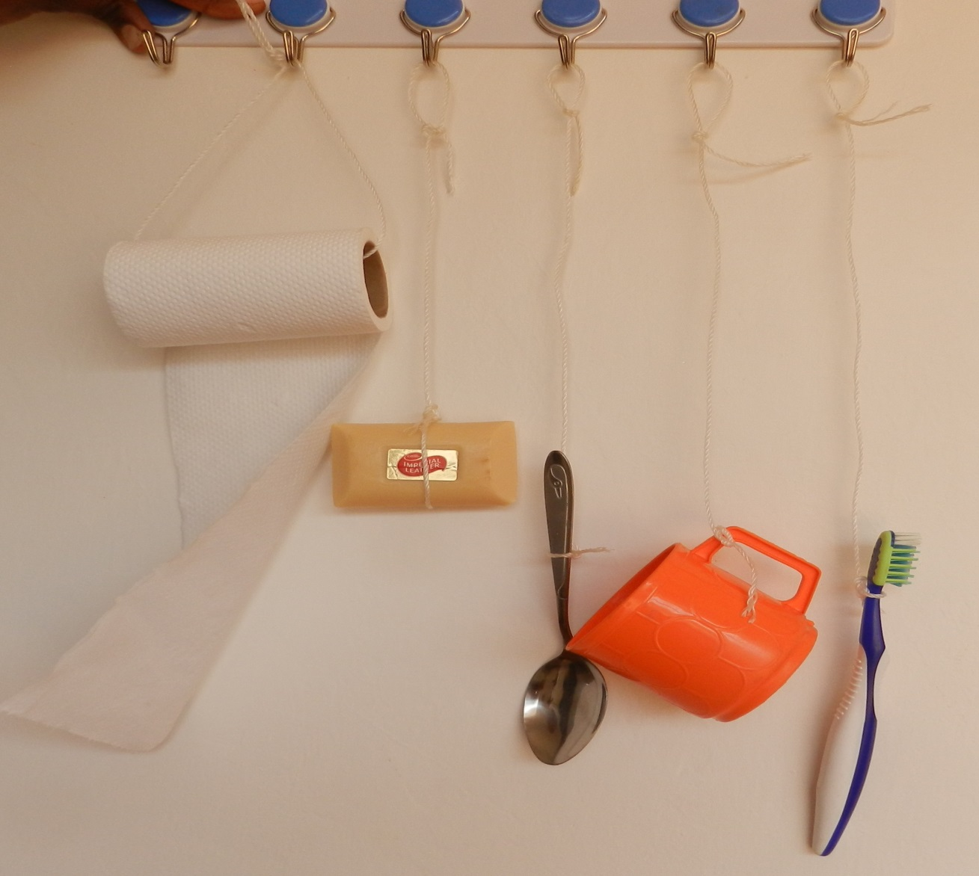
Objects of Reference

Slide 17
PRACTICAL
During the break
Feed your partner sitting slouched - give the food quickly.
Lean your head back when you drink your tea and swallow your food
Try feeding partner when they are blind-folded
Describe to the group what it was like - discuss…

Slide 18
What else?
Environment, hygiene & teeth-cleaning
Positioning
Utensils
Support with self-feeding
Responsive feeding methods – self or other

Slide 19
Hygiene
Discuss:
Hand-washing (flowing source + soap or ash + air dry – avoid shared towel)
Utensils (rinse in good water & dry in sun)
Washing children’s hands (same way as yours)
Washing children’s face before eating
Wiping table clean (use clean cloth)
Clean teeth of children at risk of chest infection before eating as well as after
Notes:
See separate guidance sheets to help

Slide 20
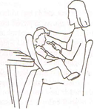
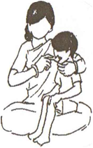
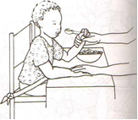
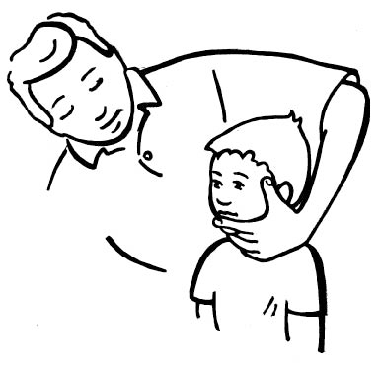
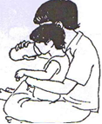
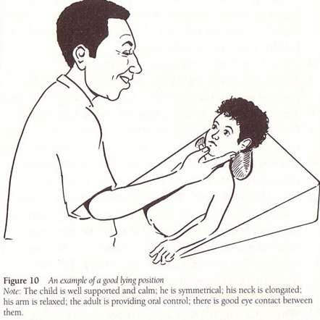
Positioning
Notes:
Discuss seating equipment (refer to previous session on this) and the compromise between acceptability for carer and child as well as what is available. Sometime need to stage progress towards optimal position.
20

Slide 21
Seating

Slide 22

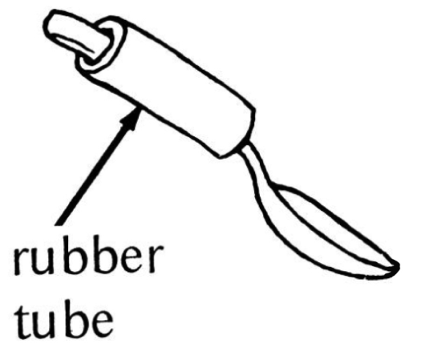
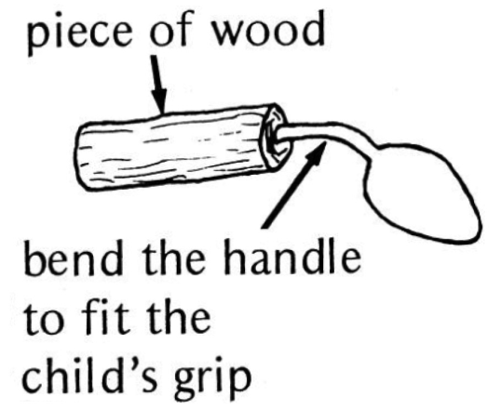

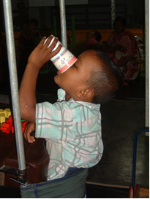

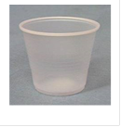
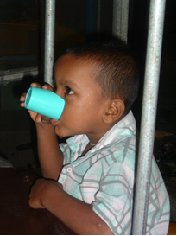

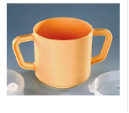
Utensils

Slide 23
Responsive and Sensitive
Talk to the child
Give small mouthfuls – food AND drink
Feed at the right speed and pause frequently for the child to rest
Watch for signs of discomfort/distress…and wait
Support them to learn to self feed with their hand first, then a spoon (hand-over-hand)
Be patient with fussy eaters. Allow them to explore food. Find out how they like their food to be presented (colour, texture, temperature, together or separate etc.)
NEVER force-feed (it is cruel, risks choking and food/drink on the lungs, causes fear and increased refusal to eat)

Slide 24
Seeking medical help
Frequent vomiting / regurgitation
Epilepsy
Severe malnutrition or dehydration
Chest infection

Slide 25
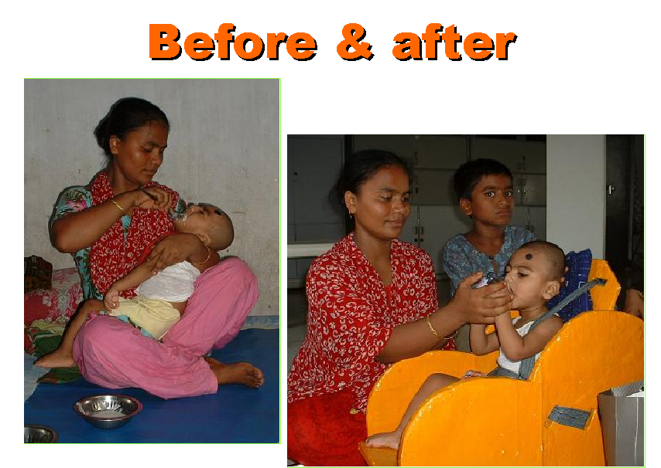
What has changed?
Notes:
Consider: positioning & seating (is child disabled by the position), utensil, speed, amount, talking to child, involvement of child, amount of coughing and spillage, contentment of child and mother.

Slide 26
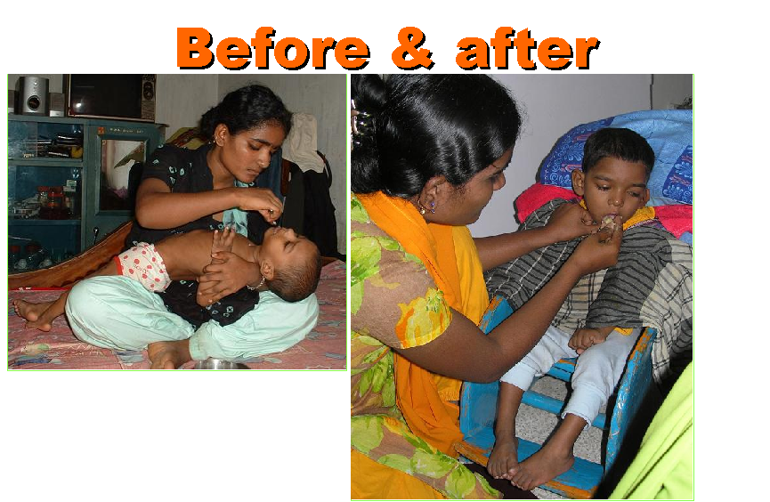
Notes:
Same prompts as slide above

Slide 27
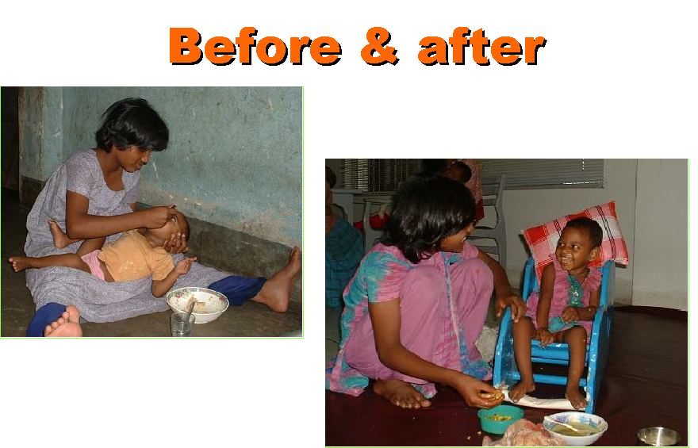
Notes:
Same prompts as slide above

Slide 28
Watch videos
Before: what suggestions would you give for change
After: what has changed? What is good about this. Is there anything you would still like to change further?
Notes:
For each video (Child 1, Child 2, Child 3) stop the video just before the end of the before clip to discuss the questions with the trainees. Do the same with the after clip.

Slide 29
What will you do differently?
Remember:
It will take time for you and your child to get used to a new way of feeding.
Be patient and keep trying because it is really worth it!
In time, mealtimes will be easier and your child will be happier and healthier.

Slide 30
Summary
Follow good hygiene practices – feeder & child
Give smaller meals more often: high nutrient & calorie content; smooth texture
Communicate with child in positive manner
Position – support child in upright position with chin slightly down (use special chair)
Use correct utensils (small plastic cup & spoon)
Feed sensitively: small mouthfuls, slowly, watching & pausing. NEVER FORCE
Go to doctor if malnourished, dehydrated, chest infection, frequent vomiting, fits (epilepsy)

Slide 31
Educational Video Drama

Slide 32
FEEDBACK
A. Knowledge before 1. low 2. medium 3. high
B. Knowledge after 1. low 2.medium 3.high
C. Training was 1. not very useful
2. somewhat useful
3. very useful

